Slide 1

Smart Gym Tracker
Increment 2 Delivery

Slide 2


What is Smart Gym Tracker
Web based gym metrics tracking application
User-friendly interface
Simple look, but powerful features
Personalized and tailored experience for each user's desires
Users can track:
Workouts
Biometrics
Trends
Goal progress

Slide 3


Delivery Goals for Increment 2
?
Get Frontend/Backend/Database Communicating
User and Identity Management (IDM)
Login Screens
Protected Admin Pages

Slide 4
Updates and changes On Project Goals
Positive Updates:
Frontend and Database on schedule for project features and releases
Documentation updated and expectations cleared up
Frontend designs and pages are on track
Database schema setup and communication created
Backend has some working functionality
Bugs:
No bugs at current time
All released systems will build and run independently
Database and frontend functioned properly on testing
Blockers:
Limited cross-system communication
Backend seen some unexpected setbacks
Makes testing of some functionality difficult

Slide 5

Demo - Frontend

Slide 6
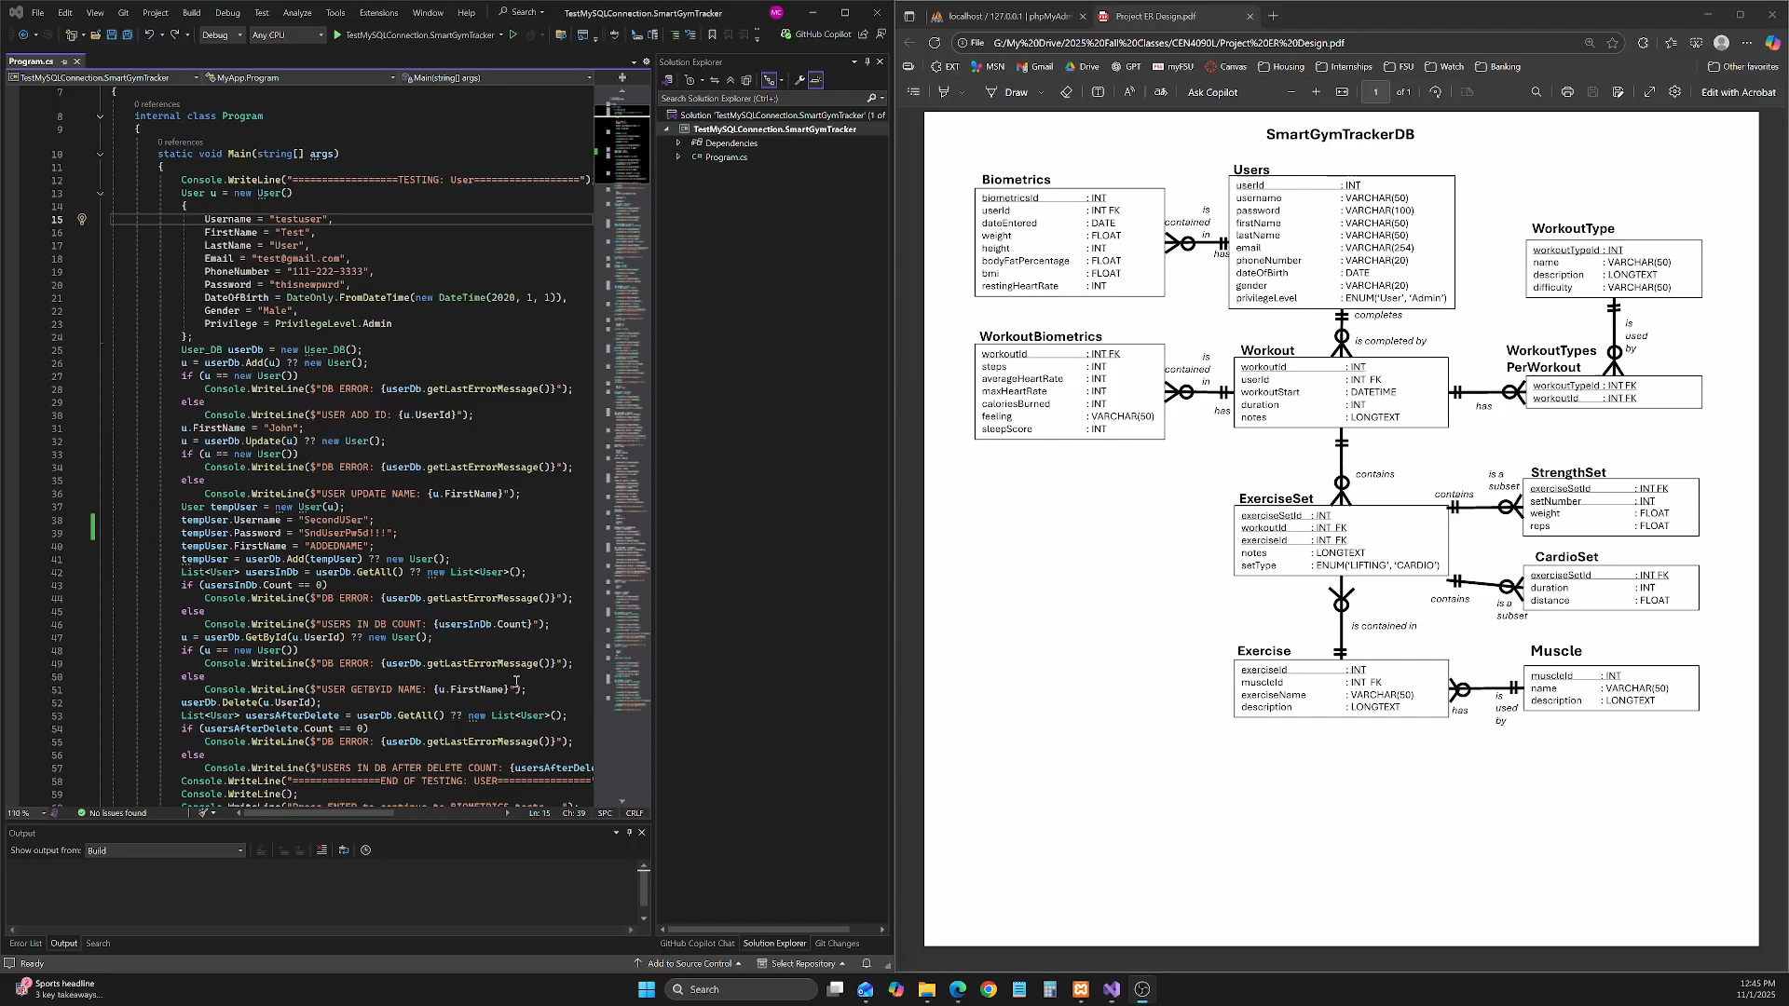
Demo - Database

Slide 7

Future Deliverables
Increment 3 Release (12/12):
Complete backend setup
Allow for full system communication
Trends of Data
See graphs of how data has changed over time
Notifications
Create user inbox dashboard messages to populate
Smart Tips and Suggestions
See goals and tips based off data trends
Milestone and Progress Tracking
Personalized goals creation
See progress over time towards these user created goals

Slide 8


Thank You
Questions?

